Slide 1

Tableau Workshop
Rob Segan, Reema Rustagi
Date and/or Location of Presentation

Slide 2
Tableau Installation

Slide 3

Tableau for Students
Tableau Academic Program:
www.tableau.com/academic/students

Slide 4
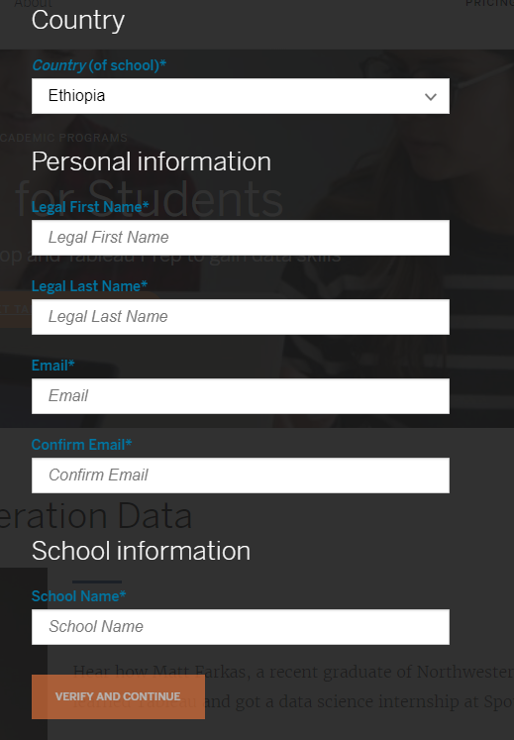
Verify Your Student Identity
You will receive an email from Tableau with instruction of how to download and activate Tableau

Slide 5

Tableau for Public
Tableau Public: public.tableau.com
Enter
your
Email

Slide 6

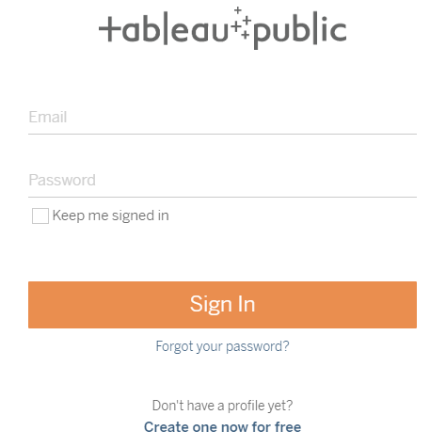
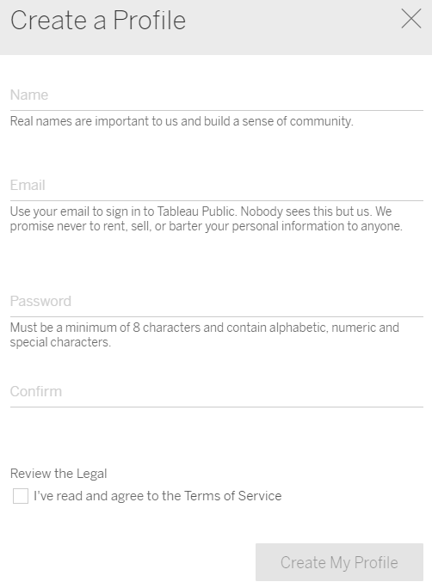
Create Tableau Public Profile to Share Your Work
Tableau Public: public.tableau.com
Right upper corner:
Create profile
Create

Slide 7
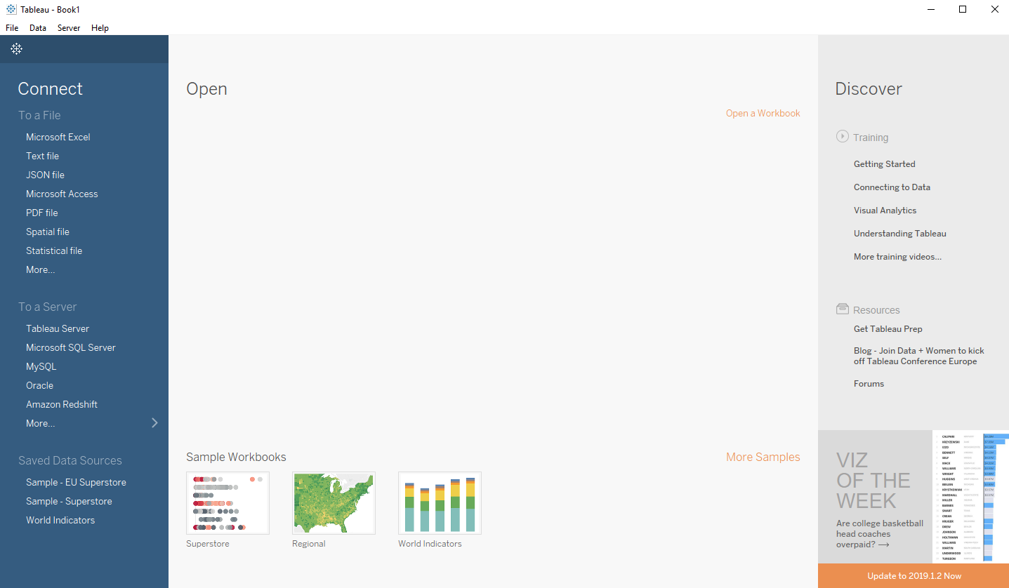
Open Tableau!
If you see above picture, you are ready to go!

Slide 8
Build Your Own Data Visualization in Tableau
Ethiopia HIV Prevalence

Slide 9
Data
- Understand data and make data useful
Today:
- Data cleaning
Visualize
- Choose right visualization format
Today:
- Line chart
- Choropleth map
Share
- Share your work for public good
Today:
- Publish to Tableau public
- Share on CGDV

Slide 10

About Data
HIV Prevalence in Ethiopia from 1992 to 2017
Population: Adult Age 15 - 49
Data source: UNAIDS
aidsinfo.unaids.org

Slide 11
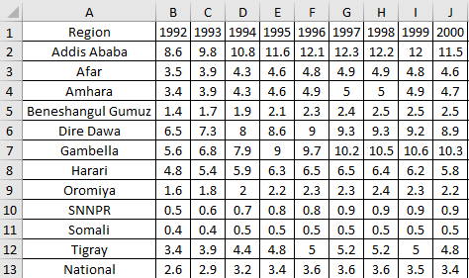
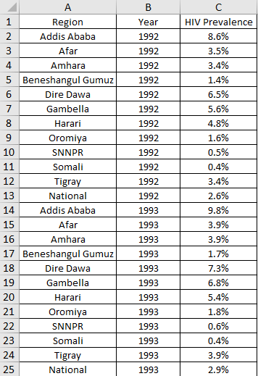
Data Cleaning
Tidy Data (by Hadley Wickham)
Each variable is saved in its own column
Each observation is saved in its own row
Each “type” of observation stored in a single table (here prevalence).
Why Tidy Data?
Easy to access variables
Automatically preserves observations

Slide 12
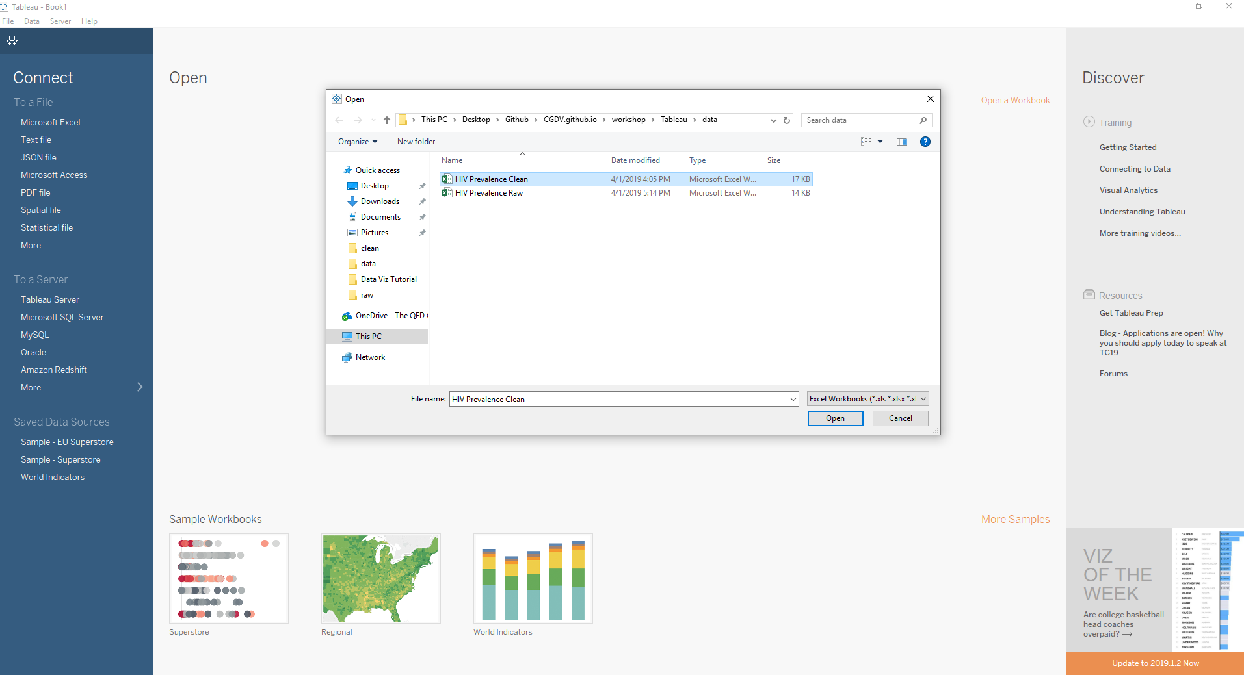


Import Data to Tableau

Slide 13
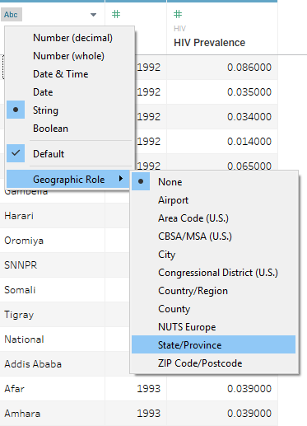
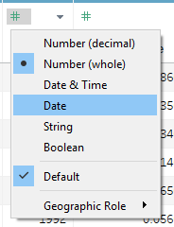
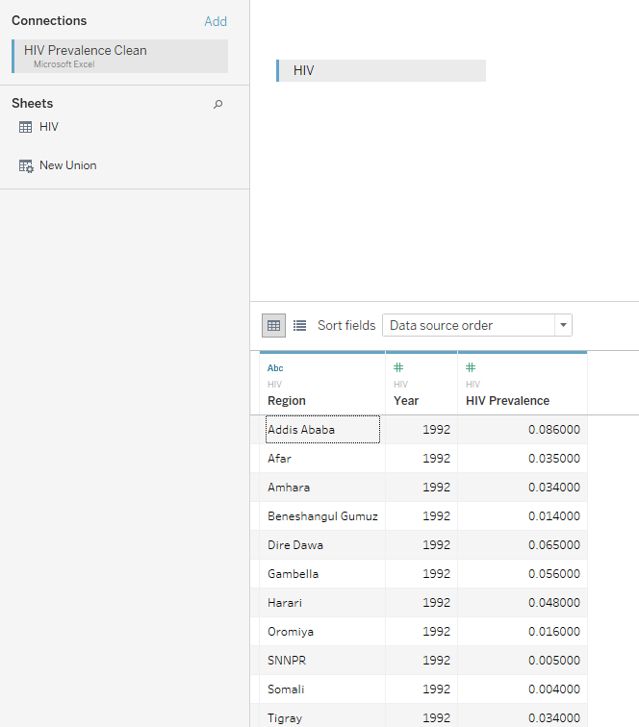


Choose Right Data Type
Region
Year

Slide 14
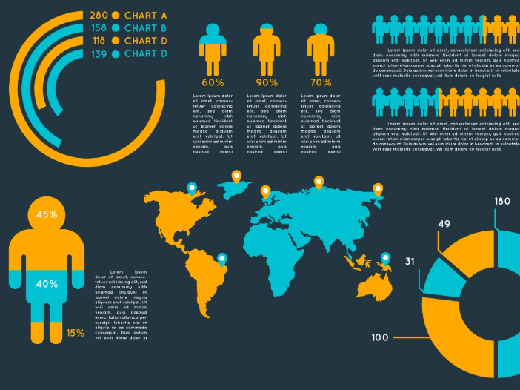

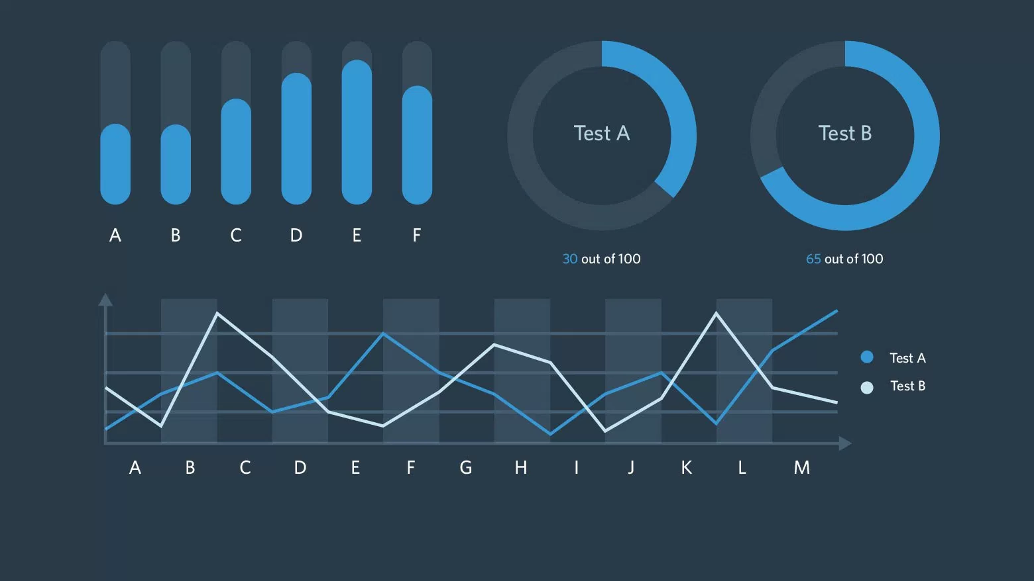
Let’s Visualize Data!

Slide 15

Tableau 101
Sheet < Dashboard < Story
Sheet: Single visualization
Dashboard: Multiple sheets
Story: Multiple sheets + dashborads

Slide 16
Tableau 101

Slide 17


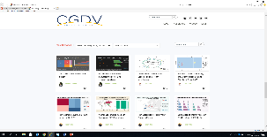
CENTER FOR GLOBAL DATA VISUALIZATION
Designed to build data visualization capacity and strengthen a culture of data use in international development
Mobilizes the power of university students to close the gap in data visualization
Collaborating universities will have access to trainings and can publish research on the CGDV platform
Notes:
Patrick- please add a visual or ask Jennifer to do this.

Slide 18
Thank You

